Slide 1
Secure Computation
Boaz Barak
Slides stolen from
Joe Kilian & Vitali Shmatikov

Slide 2


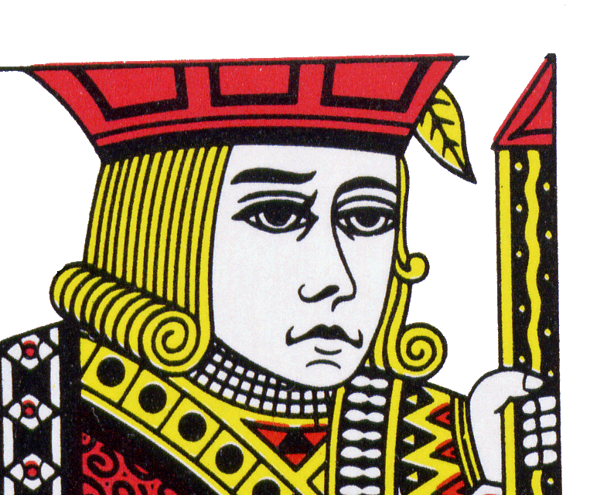
Cryptology – The First Few Millennia
Thank you, Sir Cryptographer!
Well Done!
0100101010101000111010100
Curses! I cannot read the message!
Goal of cryptology – protect messages from prying eyes.
Lockboxes for data: data safe as long as it is locked up.

Slide 3
The Last Twenty Years
Then: data protected, but not used.
Now: Use data, but still protect it as much as possible.
Secure Computation:
Can we combine information while protecting it as much as possible?

Slide 4


The Love Game (AKA the AND game)
He loves me, he loves me not…
She loves me, she loves me not…
Want to know if both parties are interested in each other.
But… Do not want to reveal unrequited love.
Input = 1 : I love you
Input = 0: I love you
Must compute F(X,Y)=XÆY, giving F(X,Y) to both players.
… as a friend
Can we reveal the answer without revealing the inputs?

Slide 5


The Spoiled Children Problem
(AKA The Millionaires Problem [Yao])
Who has more toys?
Who Cares?
Pearl wants to know whether she has more toys than Gersh, Doesn’t want to tell Gersh anything.
Gersh is willing for Pearl to find out who has more toys,
Doesn’t want Pearl to know how many toys he has.
Pearl wants to know whether she has more toys than Gersh, Doesn’t want to tell Gersh anything.
Gersh is willing for Pearl to find out who has more toys,
Doesn’t want Pearl to know how many toys he has.
Can we give Pearl the information she wants, and nothing else, without giving Gersh any information at all?

Slide 6

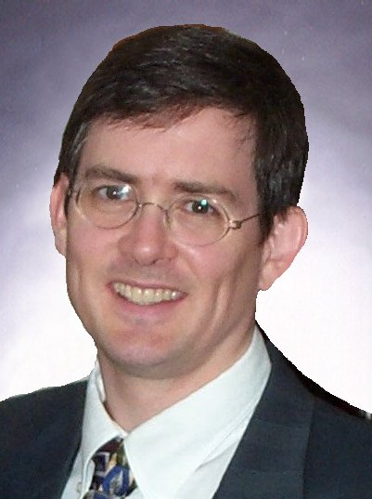



Distributed Cryptographic Entities
S₁
Public Key: P
S₂
S₃
Secret Key: S
Trusted public servant cheerfully encrypts, decrypts, signs messages, when appropriate.
Blakley,Shamir,Desmedt-Frankel…:
Can break secret key up among several entities,
Can still encrypt, decrypt, sign,
Remains secure even if a few parties are corrupted.

Slide 7


Auctions with Private Bids
$2
$7
$3
$5
$4
Auction with private bids:
Bids are made to the system, but kept private
Only the winning bid, bidders are revealed.
Can we have private bids where no one, not even the auctioneer, knows the losing bids?
Normal auction: Players reveal bids – high bid is identified along with high bidders.
Drawback: Revealing the losing bids gives away strategic information that bidders and auctioneers might exploit in later auctions.

Slide 8
Electronic Voting
War
Peace
War
Peace
Nader
Final Tally: War: 2
Peace: 2
Nader: 1
The winner is: War

Slide 9
Secure Computation
(Yao, Goldreich-Micali-Wigderson)
1
2
3
4
5
X₁
X₂
X₃
X₄
X₅
F₁(X₁,…,X₅)
F₂(X₁,…,X₅)
F₃(X₁,…,X₅)
F₄(X₁,…,X₅)
F₅(X₁,…,X₅)
Players: 1,…,N
Inputs: X₁,…,X_{N}
Outputs: F₁(X₁,…,X_{N}),…,F_{N}(X₁,…,X_{N})
Players should learn correct outputs and nothing else.

Slide 10
An Ideal Protocol
A snuff Protocol
Don’t worry, I’ll carry your secrets to the grave!
The answer is…
I’ll Help!
(for a rea-sonable con-sulting fee…)
16
Tons
X₁
X₂
F₁(X₁,X₂)
F₂(X₁,X₂)
Goal: Implement something that “looks like” ideal protocol.

Slide 11
That 80’s CIA training sure came in handy…
The Nature of the Enemy
5
0
1
1
9
0
7
1
1
0
5
4
1
Corrupting a player lets adversary:
Learn its input/output
See everything it knew, saw, later sees.
Control its behavior (e.g., messages sent)
2
0
4
7
0
1
= input
= output
= changed

Slide 12
What can go wrong?
War
War
War
War
Peace
Final Tally: Red-Blooded-American Patriots:
Terrorist-Sympathizing Liberals:
4
1
1
4
Guantanamo
The winner still is: War
The winner is: War
Privacy: Inputs should not be revealed.
Correctness: Answer should correspond to inputs.

Slide 13
What We Can/Can’t Hope For
Outputs may reveal inputs:
If candidate received 100% of the votes,
we know how you voted.
Cannot complain about adversary learning what it can by (independently) selecting its inputs and looking at its outputs.
Cannot complain about adversary altering outcome solely by (independently) altering its inputs.
Goal is to not allow the adversary to do anything else.
Definitions very subtle: Beaver, Micali-Rogaway, Canetti…

Slide 14
Formal definition
Def: Let f:{0,1}^{n}£{0,1}^{n}→ {0,1}^{n}£{0,1}^{n}.
A 2-party protocol P is an SFE for f if:
Correctness: Alice, Bob honest with inputs x,y resp. then Alice learns f₁(x,y) and Bob learns f₂(x,y)
Security for Alice: If Alice honest with input x, then for every cheating Bob*, there is a simulator S* s.t.
y
Ideal
Alice(x)
Bob*
»
S*
»
f₂(x,y)
Security for Bob: symmetric.

Slide 15
Can We Do It?
Yao (GMW,GV,K,…):
Yes!*
Cryptographic solutions require “reasonable assumptions”
e.g., hardness of factoring
*Slight issues about both players getting answer at same time.
Goldreich-Micali-Wigderson (BGW,CCD,RB,Bea,…):
Yes, if number of parties corrupted is less than some constant fraction of the total number of players (e.g., <n/2, <n/3).
No hardness assumptions necessary.
As long as functions are computable in polynomial time, solutions require polynomial computation, communication.

Slide 16
Yao’s Protocol
Compute any function securely
First, convert the function into a boolean circuit
AND
AND
NOT
Alice’s inputs
Bob’s inputs
AND
OR
OR
z
z
x
y
z
x
y
z
AND
0
0
0
OR
0
0
0
Truth table:
0
1
0
Truth table:
0
1
1
x
y
1
0
0
x
y
1
0
1
1
1
1
1
1
1

Slide 17
AND
AND
NOT
Alice’s inputs
Bob’s inputs
AND
OR
OR
Overview:
Alice prepares “garbled” version C’ of C
Sends “encrypted” form x’ of her input x
Allows bob to obtain “encrypted” form y’ of his input y
Bob can compute from C’,x’,y’ the “encryption” z’ of z=C(x,y)
Bob sends z’ to Alice and she decrypts and reveals to him z
Crucial properties:
Bob never sees Alice’s input x in unencrypted form.
Bob can obtain encryption of y without Alice learning y.
Neither party learns intermediate values.
Remains secure even if parties try to cheat.

Slide 18
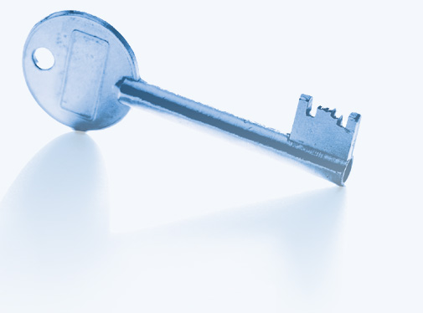

Intuition
c
AND
a
b

Slide 19
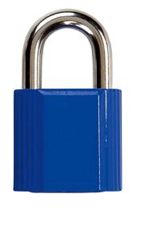
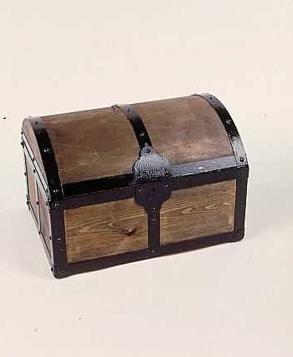
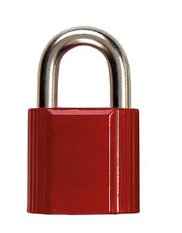
Intuition
a
b
a
b
c
a
b
AND
a
b
b
a
b
a

Slide 20
1: Pick Random Keys For Each Wire
Next, evaluate one gate securely
  Later, generalize to the entire circuit
Alice picks two random keys for each wire
  One key corresponds to “0”, the other to “1”
  6 keys in total for a gate with 2 input wires
k_{0z}, k_{1z}
z
AND
Alice
x
y
Bob
k_{0x}, k_{1x}
k_{0y}, k_{1y}

Slide 21
2: Encrypt Truth Table
Alice encrypts each row of the truth table by encrypting the output-wire key with the corresponding pair of input-wire keys
z
k_{0z}, k_{1z}
AND
Alice
x
y
Bob
k_{0x}, k_{1x}
k_{0y}, k_{1y}
E_{k0x}(E_{k0y}(k_{0z}))
x
y
z
E_{k0x}(E_{k1y}(k_{0z}))
0
0
0
Encrypted truth table:
Original truth table:
0
1
0
E_{k1x}(E_{k0y}(k_{0z}))
1
0
0
1
1
1
E_{k1x}(E_{k1y}(k_{1z}))

Slide 22
3: Send Garbled Truth Table
Alice randomly permutes (“garbles”) encrypted truth table and sends it to Bob
Does not know which row of garbled table corresponds to which row of original table
z
k_{0z}, k_{1z}
AND
Alice
x
y
Bob
k_{0x}, k_{1x}
k_{0y}, k_{1y}
E_{k1x}(E_{k0y}(k_{0z}))
E_{k0x}(E_{k0y}(k_{0z}))
E_{k0x}(E_{k1y}(k_{0z}))
E_{k0x}(E_{k1y}(k_{0z}))
Garbled truth table:
E_{k1x}(E_{k0y}(k_{0z}))
E_{k1x}(E_{k1y}(k_{1z}))
E_{k1x}(E_{k1y}(k_{1z}))
E_{k0x}(E_{k0y}(k_{0z}))

Slide 23
4: Send Keys For Alice’s Inputs
Alice sends the key corresponding to her input bit
  Keys are random, so Bob does not learn what this bit is
k_{0z}, k_{1z}
z
Learns K_{b’x} where b’ is Alice’s input bit, but not b’ (why?)
AND
Alice
x
y
Bob
k_{0x}, k_{1x}
If Alice’s bit is 1, she
simply sends k_{1x} to Bob;
if 0, she sends k_{0x}
k_{0y}, k_{1y}
E_{k1x}(E_{k0y}(k_{0z}))
Garbled truth table:
E_{k0x}(E_{k1y}(k_{0z}))
E_{k1x}(E_{k1y}(k_{1z}))
E_{k0x}(E_{k0y}(k_{0z}))

Slide 24
5: Use OT on Keys for Bob’s Input
Alice and Bob run oblivious transfer protocol
  Alice’s input is the two keys corresponding to Bob’s wire
  Bob’s input into OT is simply his 1-bit input on that wire
z
Knows K_{b’x} where b’ is Alice’s input bit and K_{by} where b is his own input bit
k_{0z}, k_{1z}
AND
Alice
x
y
Bob
k_{0x}, k_{1x}
Run oblivious transfer
Alice’s input: k_{0y}, k_{1y}
Bob’s input: his bit b
Bob learns k_{by}
What does Alice learn?
k_{0y}, k_{1y}
E_{k1x}(E_{k0y}(k_{0z}))
Garbled truth table:
E_{k0x}(E_{k1y}(k_{0z}))
E_{k1x}(E_{k1y}(k_{1z}))
E_{k0x}(E_{k0y}(k_{0z}))

Slide 25
6: Evaluate Garbled Gate
Using the two keys that he learned, Bob decrypts exactly one of the output-wire keys
  Bob does not learn if this key corresponds to 0 or 1
    Why is this important?
z
Knows K_{b’x} where b’ is Alice’s input bit and K_{by} where b is his own input bit
k_{0z}, k_{1z}
AND
Alice
x
y
Bob
k_{0x}, k_{1x}
Suppose b’=0, b=1
k_{0y}, k_{1y}
E_{k1x}(E_{k0y}(k_{0z}))
E_{k0x}(E_{k1y}(k_{0z}))
This is the only row
Bob can decrypt.
He learns K_{0z}
Garbled truth table:
E_{k1x}(E_{k1y}(k_{1z}))
E_{k0x}(E_{k0y}(k_{0z}))

Slide 26
7: Evaluate Entire Circuit
In this way, Bob evaluates entire garbled circuit
  For each wire in the circuit, Bob learns only one key
  It corresponds to 0 or 1 (Bob does not know which)
    Therefore, Bob does not learn intermediate values (why?)
Bob tells Alice the key for the final output wire and she tells him if it corresponds to 0 or 1
  Bob does not tell her intermediate wire keys (why?)
AND
AND
NOT
Alice’s inputs
Bob’s inputs
AND
OR
OR

Slide 27
8: Making it robust
So far, protocol is only secure for
honest-but-curious (aka semi-honest) adversaries:
Alice can prepare faulty circuit (e.g. C(x,y)=y).
Bob can give Alice wrong output.
Solutions:
Alice proves in zero knowledge that garbled circuit is correct. (Need also proofs of knowledge for inputs.)
“cut and choose” – Alice prepares several copies of garbled circuit. Bob asks to “open up” some of them, and then they use an unopened one to compute.

Slide 28
Can We Really Do It?
General solutions as impractical as they are beautiful.
Step 1:
Break computations to be performed into itsy-bitsy steps.
(additions, multiplications, bitwise operations)
Step 2:
For each operation...
Step 3:
Despair at how many itsy-bitsy steps your computation
takes.
Is there any hope?

Slide 29
Signs of Hope
Sometimes, don’t need too many itsy-bitsy operations.
Naor-Pinkas-Sumner
Functions computed when running auctions are simple.
Highly optimize Yao-like constructions.
Testing if two strings are equal is very practical.
Can exploit algebraic structure to minimize work.
Rabin: Can compute sums very efficiently

Slide 30
Electronic Voting
Most extensively researched subarea of secure computation.
Protocols are now very practical.
100,000 voters a piece of cake,
1,000,000 voters doable.
Several commercial efforts
Chaum, Neff, NEC,…
Many interesting issues, both human and technical:
What should our definitions be?

